Slide 1
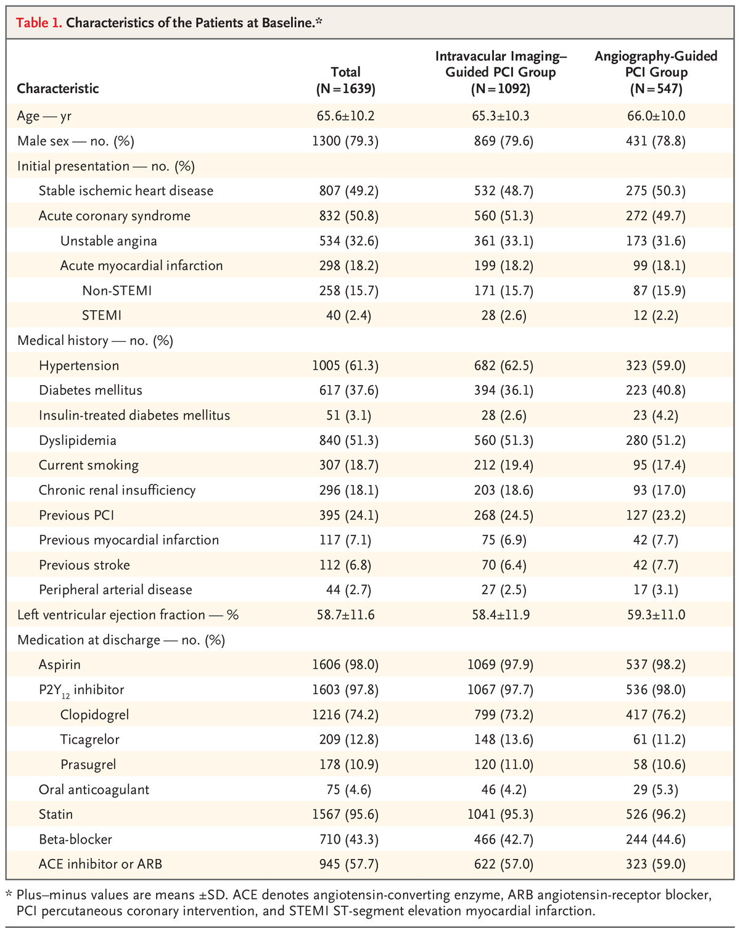

Characteristics of the Patients at Baseline.*
JM Lee et al. N Engl J Med 2023;388:1668-1679.
Notes:
Table 1. Characteristics of the Patients at Baseline. *

